Slide 1
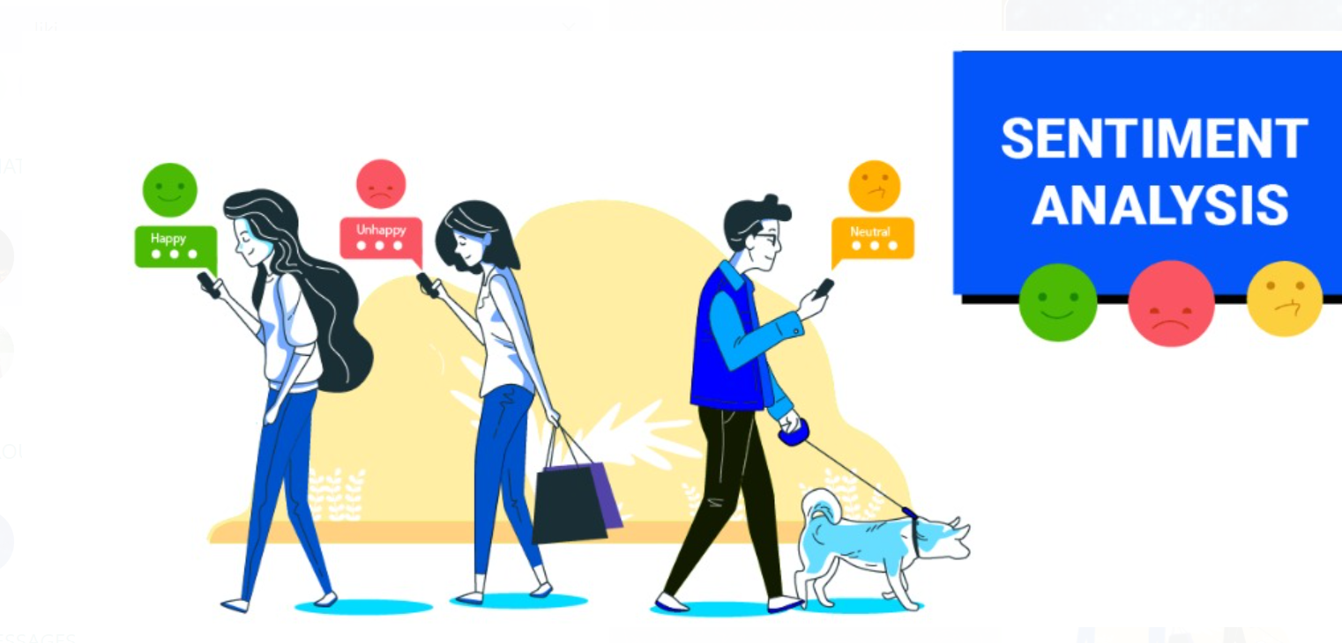
Financial News Sentiment Analysis Using NLP & Machine earning
Presented by
Pradeep Varma
Santhosh
Sai Kumar
Sushmita
Likitha

Slide 2
Table of contents
Problem Statement
Introduction
Understanding the Dataset
Data Analytics and Visualization
Model Training and Validation
Flask deployment
Future Enhancements
Challenges and Learning
Conclusion

Slide 3
Problem Statement
How can we accurately predict the direction of stock price movement by analyzing the sentiment expressed in financial news articles, social media posts, and other textual data?
Can we accurately assess the impact of corporate announcements, such as earnings reports or mergers, on stock prices by analyzing the sentiment expressed in related news and social media discussions?

Slide 4
Introduction
This project focuses on analyzing financial sentiment to assist the company in making informed investment decisions.
Sentiment analysis in finance is crucial as it helps to assess market emotions, influencing stock price movements and financial stability.
In this project, we will develop a machine learning-based model to analyze news articles.
The goal is to classify market sentiment as positive, negative, or neutral, providing valuable insights for strategic financial decision-making.

Slide 5
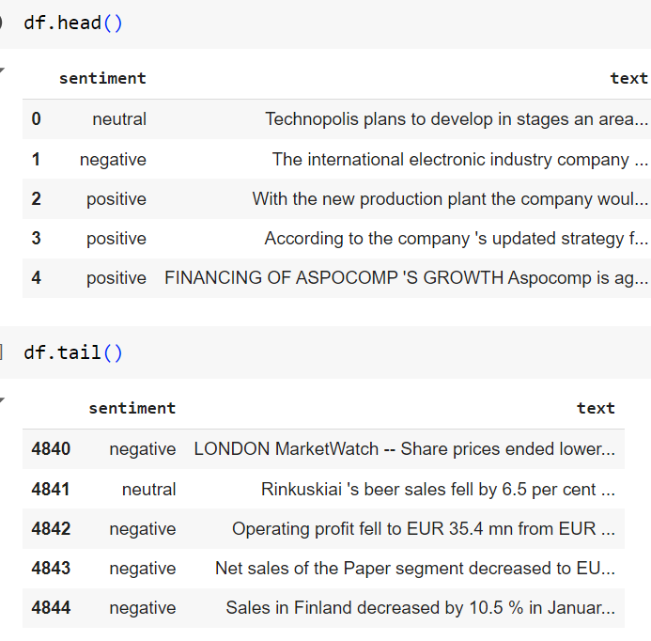
Understanding the Dataset
The Dataset contains 2 features, Sentiment and Text and a total of 4845 rows of data
The Text column contains the actual text content that is being analyzed for sentiment.
Based on the type of Text the Sentiment is classified into 3 Categories – Positive, Neutral, and Negative

Slide 6
Sentiment Classification:
In our analysis of the dataset, we understood that sentiment is classified into three main categories based on the presence of specific words and phrases in the text:
Positive :
The text containing words such as “increase”, “growth”, “successful” and "well-received” etc.… are classified as positive. These words indicate favorable outcomes.
2. Neutral :
The text containing words such as "planning”, "proposed" and "reported" etc.… are classified as neutral. These words don’t indicate favorable/unfavorable outcomes strongly.
3. Negative :
The text containing words such as "decline“, "loss“, "layoff“ and "decrease" etc.… are classified as negative. These words indicate unfavorable outcomes.

Slide 7
Data Analytics and Visualization
Handling null Values
Data Cleaning
EDA
Algorithms

Slide 8
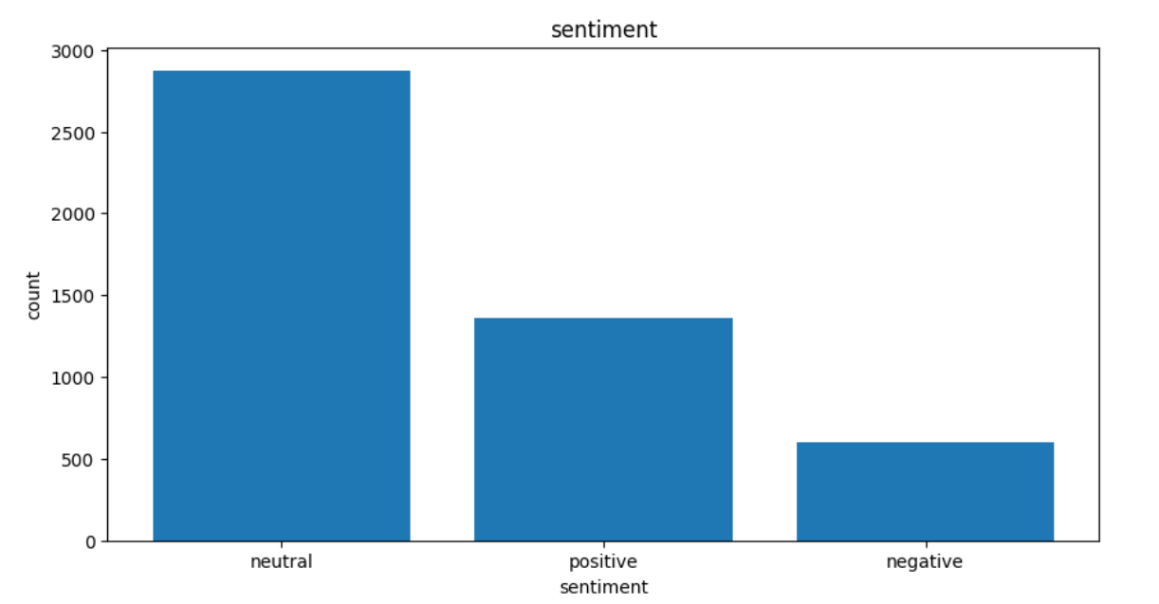
EDA (Exploratory Data Analysis)
The visualization shows the distribution of sentiment labels in the dataset.
The majority of instances are classified as "neutral," indicating a lack of strong positive or negative sentiment.
The class imbalance, with fewer positive and negative instances, should be considered when training and evaluating machine learning models.

Slide 9
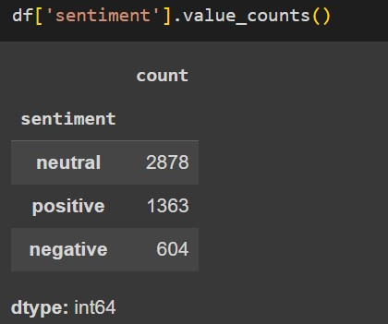
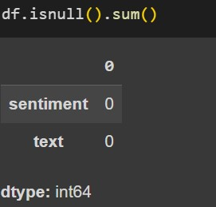
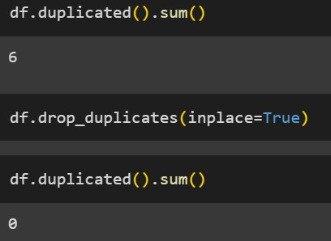
In this diagram shows how the sentiment is distributed
In this diagram shows Null Values Distribution of a Dataset
There is NO NULL values in this Dataset
In this dataset we found out 6 duplicate Values we are dropped those duplicates

Slide 10
Tokenization, Lemmatization, and Word Embedding
Tokenization: Breaking text into smaller units (tokens).
Types: Word, Subword, Character.
Example: “I love programming” → [“I”, “love”, “programming”]
Lemmatization: Reducing words to their base form (lemma).
Example: "running" → "run“
Difference from Stemming: Lemmatization is context-aware; stemming is a simple cut-off.
Word Embedding: Mapping words to vectors that capture meaning.
Methods: TF-IDF, Word2Vec, GloVe.
Example: "king - man + woman = queen"
Applications: Sentiment analysis, machine translation, question answering.

Slide 11
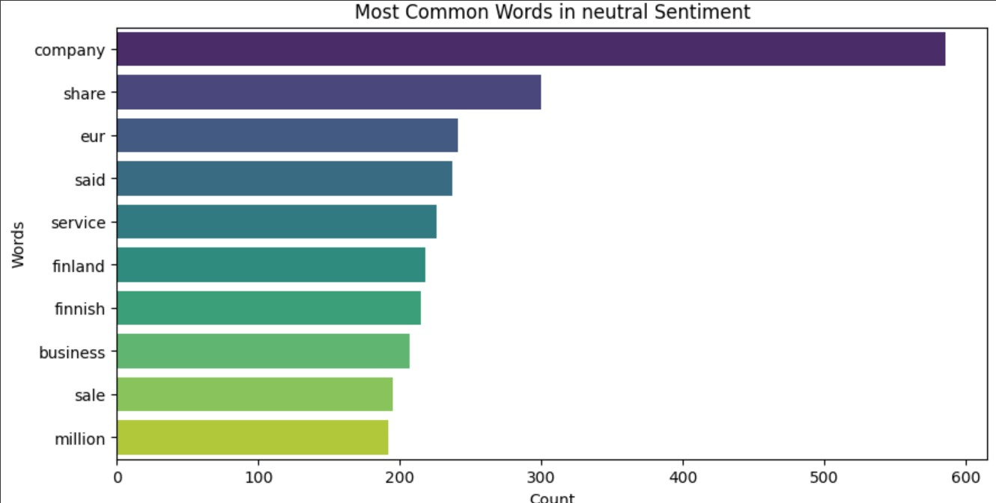
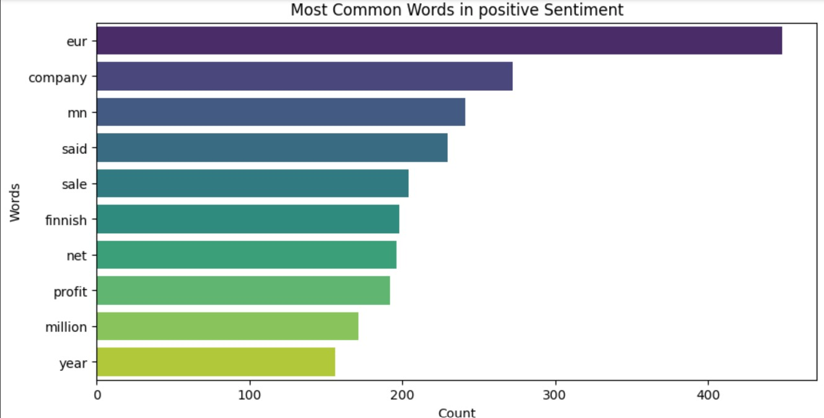
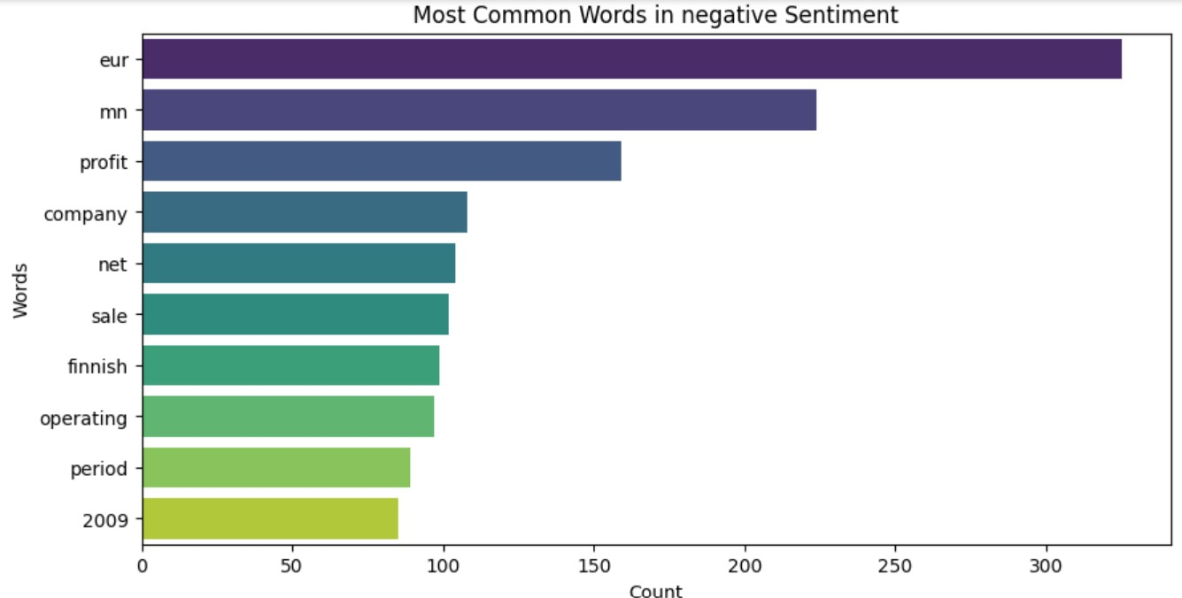
The Most Frequently Repeated words in sentiment

Slide 12
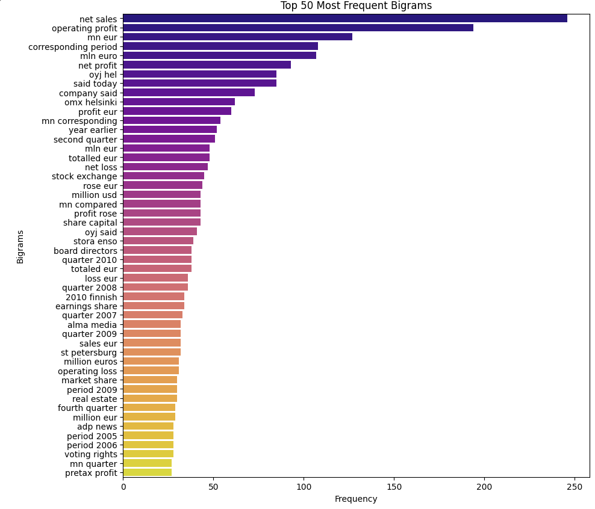
The bar chart shows the frequency of the top 50 most frequent bigrams (two-word combinations) extracted using natural language processing (NLP) techniques from a given dataset. The x-axis represents the frequency of occurrence, and the y-axis lists the bigrams. The chart reveals the most commonly used word pairs in the dataset, providing insights into the language patterns and topics discussed.

Slide 13
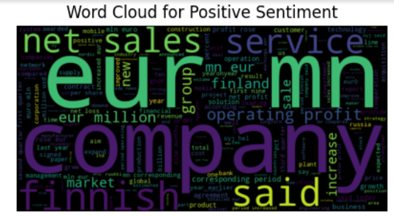
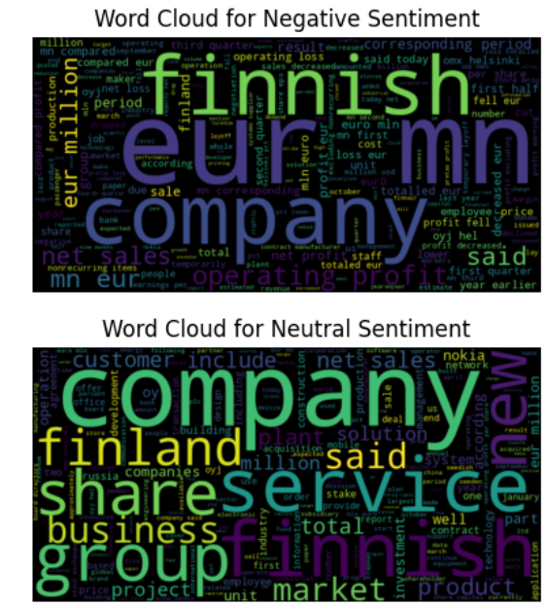
Word Cloud for Positive Sentiment: Words like "sales," "service," "new," and "million" are prominent, suggesting positive sentiment is associated with business activity and growth.
Word Cloud for Negative Sentiment: Words like "loss," "fell," and "operating loss" are prominent, indicating negative sentiment is related to financial losses and declines.
Word Cloud for Neutral Sentiment: Words like "company," "finland," and "service" appear frequently, suggesting neutral sentiment is associated with general business-related topics.
.

Slide 14
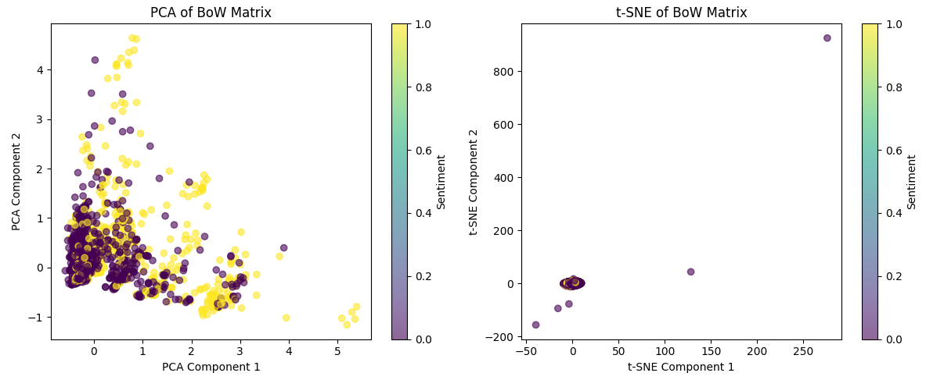
Both PCA and t-SNE have produced clusters in the data, suggesting underlying patterns.
The color-coded points representing different sentiment labels appear to be somewhat separated, indicating a relationship between the reduced dimensions and sentiment.
PCA and t-SNE have produced different visualizations, highlighting the strengths and weaknesses of each technique.
Further analysis is needed to fully understand the implications of these findings.

Slide 15
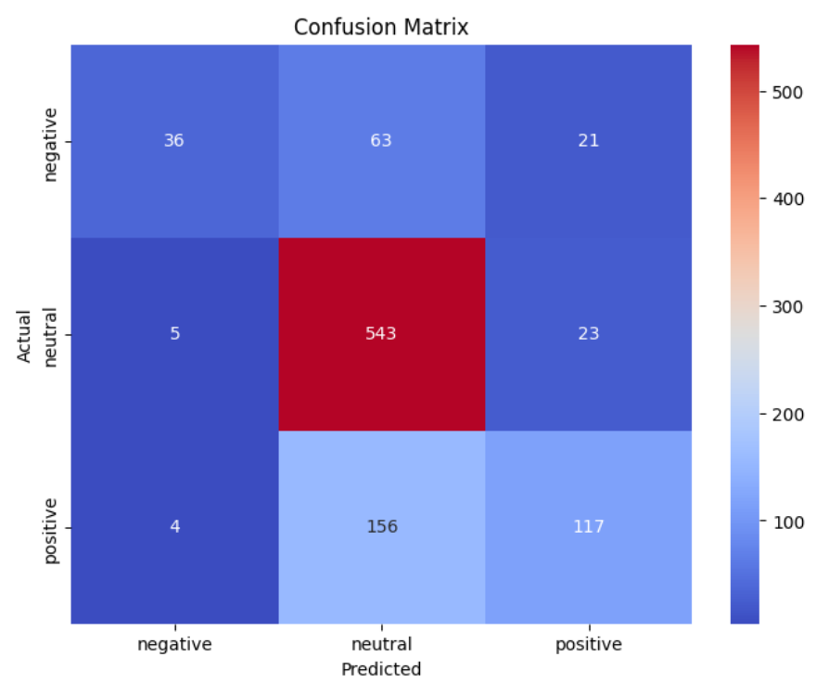
confusion matrix visualizes the performance of a classification model. The diagonal elements represent correct predictions, while off-diagonal elements indicate misclassifications. The color-coded heatmap shows the distribution of predictions across the actual classes. In this case, the model appears to be performing well in classifying the "neutral" class but struggles with distinguishing between "negative" and "positive" sentiments.

Slide 16
Model Training and Validation
Logistic Regression
Decision Tree Classifier
Random Forest Classifier
SVM (Support Vector Machine)
KNN (k- nearest neighbour)

Slide 17
Logistic Regression
Logistic regression is a powerful machine learning algorithm well-suited for binary classification tasks like sentiment analysis. It provides probability scores for each class, making it useful for understanding the degree of sentiment. The algorithm is computationally efficient and interpretable, making it a popular choice for financial applications. By effectively leveraging logistic regression, you can gain valuable insights from textual data and make informed decisions in the financial domain.
Accuracy value
Accuracy value
0.8584345130457246
0.71900826446281

Slide 18
Decision Tree Classifier
Decision trees are a powerful tool for financial sentiment analysis due to their interpretability, ability to handle categorical data, and capacity to capture non-linear relationships. They can provide insights into the most influential factors affecting sentiment and are generally efficient to train and make predictions. However, overfitting can be a concern, especially with large datasets. By addressing this limitation through techniques like pruning, decision trees can offer a valuable approach for analyzing financial sentiment.
Accuracy value
Accuracy value
0.999483337638853
0.6952479338842975

Slide 19
Random Forest Classifier
Random forests are a powerful ensemble method for financial sentiment analysis, offering improved accuracy and reduced overfitting compared to individual decision trees. They can effectively handle large datasets and provide insights into the most influential factors affecting sentiment.
Accuracy value
Accuracy value
0.999483337638853
o.7262396694214877

Slide 20
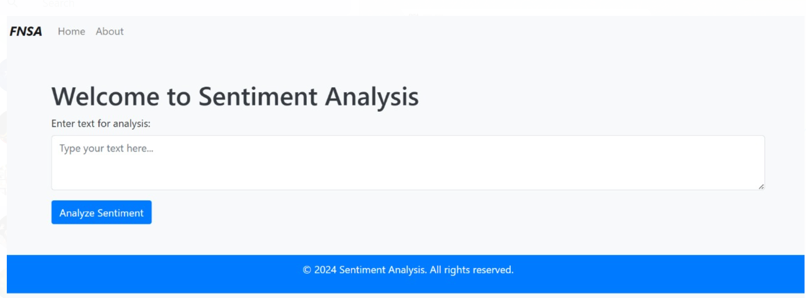
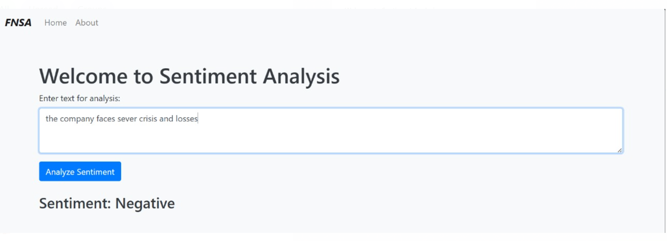
simple sentiment analysis tool. Users input text into the provided field, and the tool analyzes the sentiment expressed in the text. In the the input text "the company faces severe crisis and losses" is analyzed, and the tool correctly identifies the sentiment as "Negative."
Flask deployment

Slide 21
Future Enhancements
Incorporate contextual understanding:
Leverage advanced NLP techniques like named entity recognition and sentiment analysis to capture nuances in financial language.
Consider factors like time-series analysis to account for temporal dependencies in financial news and social media discussions.
Improve the accuracy and reliability of sentiment predictions by understanding the context of statements.
2. Explore deep learning models:
Experiment with deep learning architectures like RNNs and LSTMs to capture long-term dependencies in text.
Utilize transformer-based models like BERT or GPT-3 for more sophisticated language understanding and generation tasks.
Achieve higher accuracy in sentiment prediction by leveraging the power of deep learning.

Slide 22
Challenges and Learning
Data Quality and Noise:
Financial data can be noisy, inconsistent, and subject to biases.
Preprocessing techniques like data cleaning and normalization are crucial to improve data quality.
Addressing biases in the data is essential for accurate sentiment analysis.
2. Subjectivity and Contextual Understanding:
Sentiment can be subjective and context-dependent.
Incorporating contextual information can help models better understand sentiment.
Using advanced NLP techniques can improve the model's ability to capture nuances in language.

Slide 23
Conclusion
Financial sentiment analysis using machine learning can significantly improve decision-making in the financial domain.
These models can provide valuable insights into market sentiment, investor behavior, and potential risk factors by analyzing textual data.
Key takeaways include the importance of high-quality data, effectiveness of machine learning algorithms, value of incorporating contextual information, and need for continuous improvement.
Future research should focus on developing advanced NLP techniques, exploring deep learning models, addressing ethical considerations, and integrating sentiment analysis with other financial technologies.

Slide 24
Thank you

